Slide 1
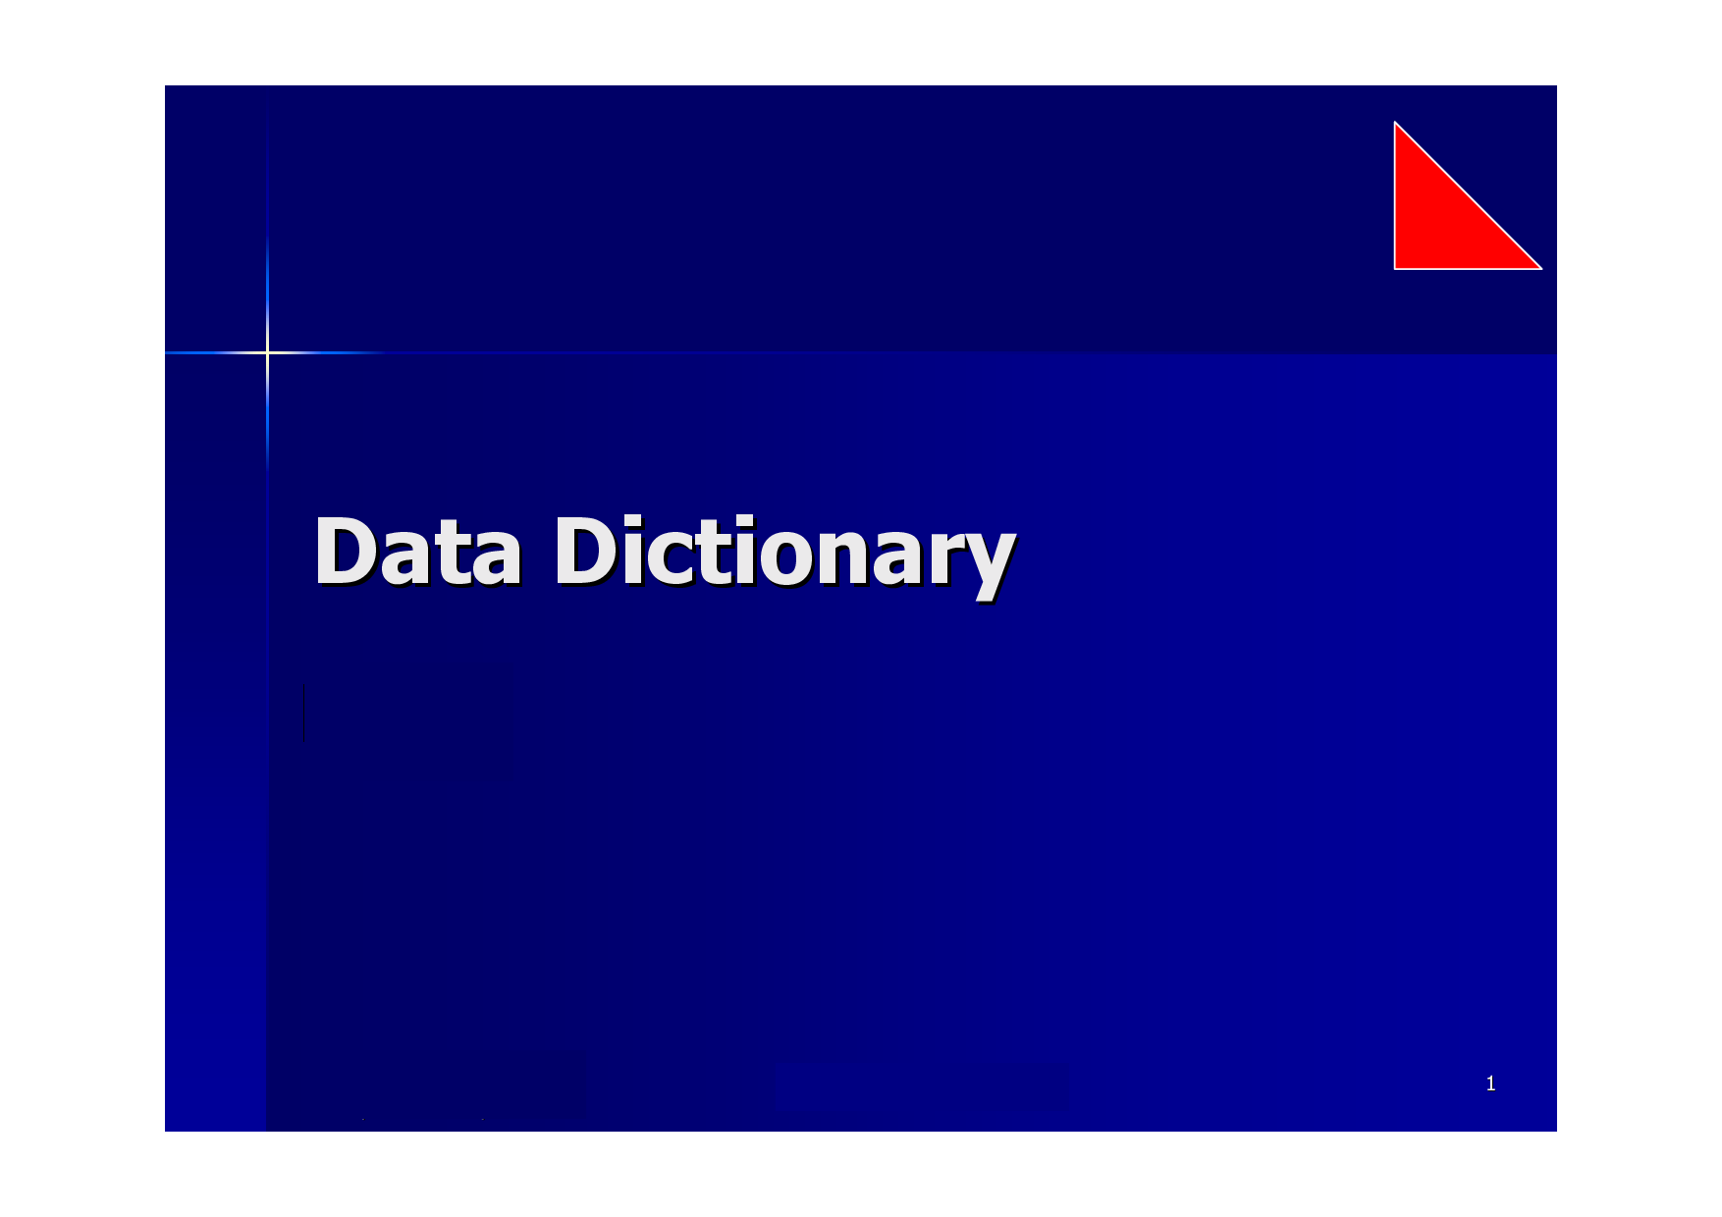

Slide 2
TOPICS
1) Use the Data Dictionary Views to Research Data on your Objects.
1.a) Introduction
1.b) SYS Account
1.c) Dynamic Performance Views
1.d) Reading comments
1.e) Adding Comments
2) Query Various Data Dictionary Views.
2.a) DICTIONARY
2.b) Identifying a user's Owned Objects
2.c) Inspecting Tables and Columns
2.d) Compiling Views
2.e) Inspecting Constraints
2.f) Finding Columns

Slide 3
1.a) Introduction
The Data Dictionary is a Collection of database Tables and Views.
Information stored in the DD includes description of all the database objects like Tables, Views, Indexes,Constraints, Synonyms, Sequences etc....
DD is nothing but "METADATA" -- Data about Data.
Every object created by every user is documented within the DD.

Slide 4
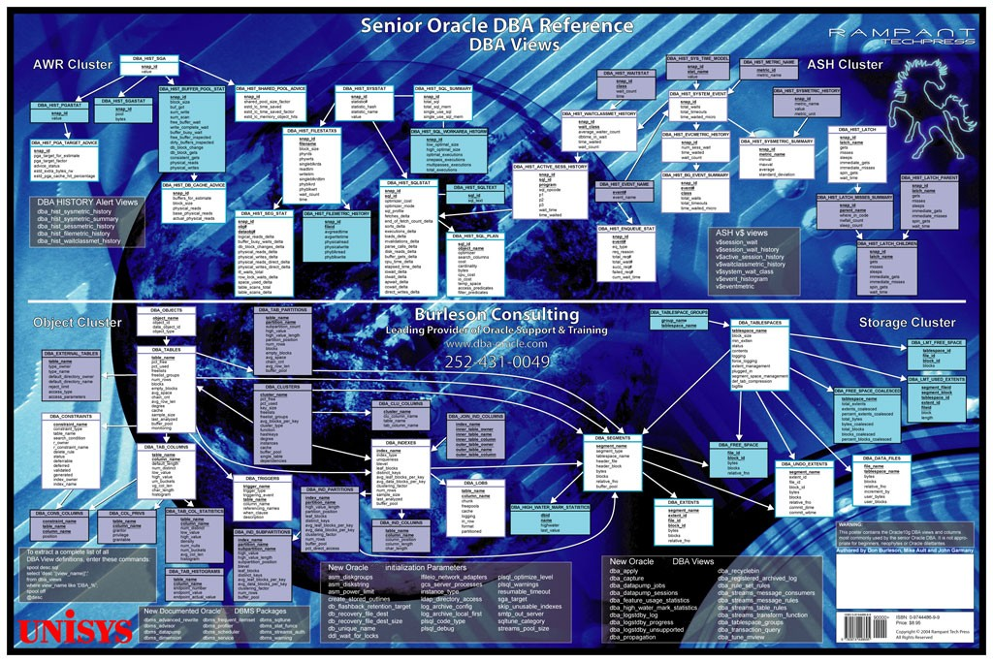
Oracle data dictionary internal structures.

Slide 5
1.b) SYS Account
The DD objects are owned by the user account called SYS Account. He got the full privileges over every tables and views.
This is one of a few powerful accounts that comes with every implementation of the Oracle database.
Every DDL statement that is issued throughout the database causes an automatic update to the DD.

Slide 6
QUES :
HOW WILL U FIND THE INFORMATION ABOUT THE TABLES OWNED BY THE CURRENT USER ACCOUNT?

Slide 7
ANS: USER_TABLES -- we gets detailed information about the tables owned by whatever account we are logged.
A full description of the USER_TABLES view would show that it consists of 50 columns. Like.
- TABLE_NAME : The name of the table.
- STATUS : Indicates whether or not the table is currently valid and therefore available for use.
- AVG_ROW_LEN : The average length of the rows currently stored in the table.

Slide 8
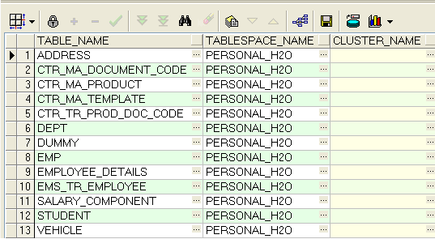
Example for USER_TABLES
SELECT * FROM USER_TABLES;

Slide 9
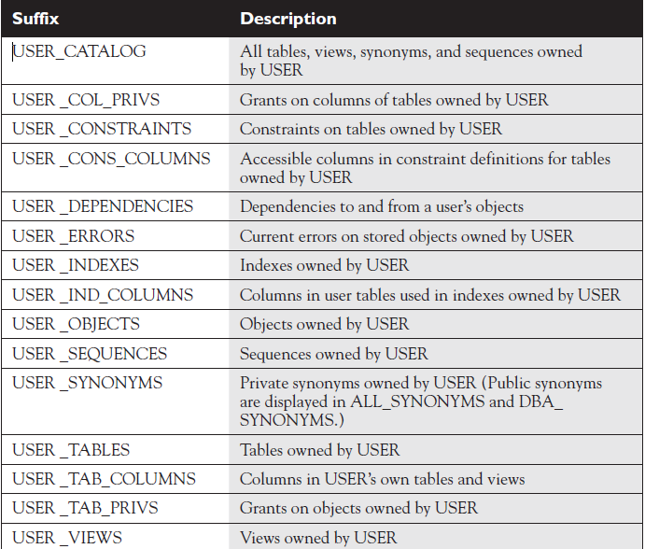
Selected DD views owned by the current user :(DEMO)

Slide 10
QUES :
But what if we wish to see information about tables other than your own?

Slide 11
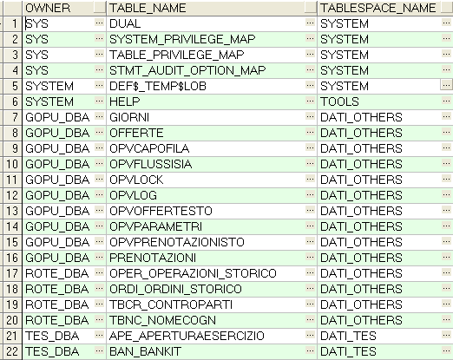
ANS : There are two other views in the data dictionary –
1) ALL_TABLES --> Shows information about the tables which user as privileges.
eg. SELECT * FROM ALL_TABLES;

Slide 12
2) DBA_TABLES --> shows all the tables in the entire DATABASE.
Eg:- SELECT * FROM DBA_TABLES;
- Shows all the details about the entire database.

Slide 13
QUES :
How will You monitor your database for real time performance?

Slide 14
1.c) Dynamic Performance Views (DPV)
Dynamic performance views display information about current database activity in real time.
We can call it as V$ to shorten the name.

Slide 15

Difference between DD and DPV
DD – It lists the parts of the car details like Seats, Wheels, lights etc…
shows the picture of where they are located.

Slide 16
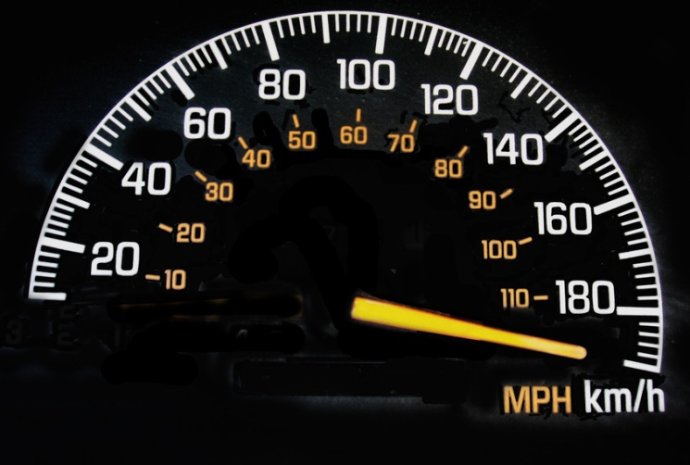
Dynamic Performance View : If we want to know how fast the car is moving means ?
  we can go with DPV
  It is like Speedometer which shows how fast our car is moving
  Shows details about how fast our db is.

Slide 17
It will be useful to:
- See who is on the system ?
- See what SQL users are running on the system ?
- See what session is blocking other session ?
- See what waits are occurring in your database. ?
Etc….

Slide 18
Some of the dynamic performance synonyms:
QUES : How will u View current Oracle users?
ANS : V$session
Eg: select * from v$session where username is not NULL;
- Displays active connection,login times,machine name etc..

Slide 19

  V$DATABASE: Information about the db. It includes db name, the date created, the current operating system information etc..

Slide 20

V$INSTANCE : Includes the instance name, the host name, the startup time etc..
Ex:

Slide 21
V$PARAMETER : The current settings for system parameters.
Option Name | Description
NLS_CALENDAR | The calendar for the session.
NLS_CURRENCY | The local currency symbol for the L number format element for the session.
NLS_DATE_FORMAT | The default format for DATETIME values.
NLS_DATE_LANGUAGE | The language for days, months, and similar language-dependent DATE format elements.
NLS_DUAL_CURRENCY | A second currency symbol in addition to the local currency symbol (which is identified by NLS_CURRENCY). It is used primarily to identify the Euro symbol.
NLS_ISO_CURRENCY | The international currency symbol for the C number format element.
NLS_LANG | The current language, territory, and database character set, which are determined by session-wide globalization parameters.
NLS_NUMERIC_CHARACTERS | The decimal marker and thousands group marker for the session.
NLS_SORT | the sequence of character values used when sorting or comparing text.

Slide 22
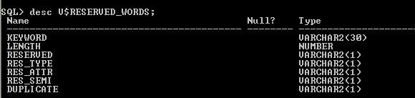
V$RESERVED_WORDS : Current list of reserved words, including information indicating if the keyword is always reserved or not

Slide 23
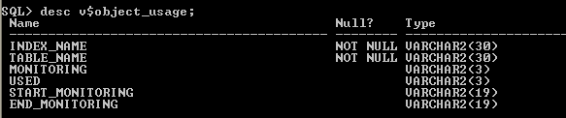
V$OBJECT_USAGE : Useful for monitoring the usage of INDEX objects

Slide 24
1.d) Reading Comments
Used to read comments of various views and its columns of the DD .
ALL_TAB_COMMENTS : Displays comments for all objects in the DB.
Eg :select * from all_tab_comments;
ALL_COL_COMMENTS : Displays comments for all columns of all tables and views in the db.
Eg: select * from all_col_comments where table_name = 'USER_JOBS';

Slide 25
1.d) Adding Comments
We can also add comments to the DD about the tables and columns we create.
COMMENT statement is used to add comments to the DD
Syntax : COMMENT ON object_typeName IS c1;
Eg: COMMENT ON TABLE AIRPORT IS ‘Listing of all flights’;
QUERY : SELECT COMMENTS FROM USER_TAB_COMMENTS WHERE TABLE_NAME=‘AIRPORT’;
COMMENTS
-----------------------------------------------
Listing of all flights

Slide 26
Adding comment to a table column:
Eg:
COMMENT ON COLUMN
AIRPORT.FLIGHTNAME IS
‘Lufthansa is very special flight’
Drop a comment:
COMMENT ON TABLE AIRPORT IS ’ ’;

Slide 27
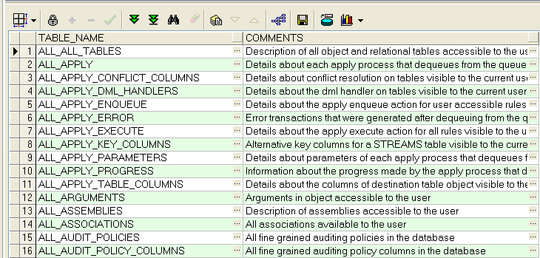
2.a) DICTIONARY
DESC DICTIONARY;
Name Null Type
------------------------------ -------- ------------------------
TABLE_NAME VARCHAR2(30)
COMMENTS VARCHAR2(4000)
Ex: SELECT TABLE_NAME, COMMENTS FROM DICTIONARY ORDER BY TABLE_NAME;

Slide 28
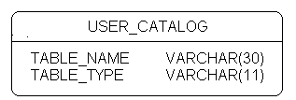
Data about our owned user account objects
Two Views :
  1) USER_CATALOG – Summary listing of tables,views,synonyms and sequences owned by user.

Slide 29
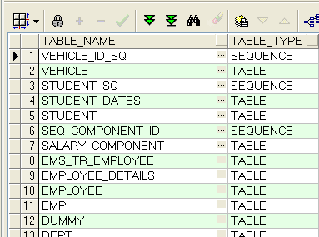
Ex: SELECT * FROM USER_CATALOG;

Slide 30
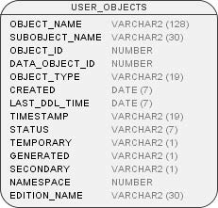
2) USER_OBJECT :
Information about all the objects owned by the user.

Slide 31
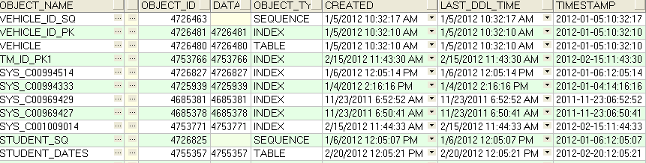
EX: SELECT * FROM USER_OBJECTS;

Slide 32
Compiling Views
Used to check the status of the View which we have created.
  View is a named query based on a table
  We have to recompile the view if the table is altered.
  For example, modifying a column in a table which is used by the view – then the status of the view is INVALID.

Slide 33
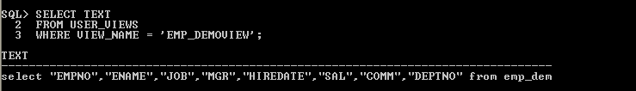
USER_VIEWS: show the query of the table
Ex:

Slide 34
INSPECTING CONSTRAINTS
USER_CONSTRAINTS :
  Used to check the state of the constraints in the table.
  CONSTRAINT_TYPE : identify which type of constraints.
  Possible entries are:
    P = PRIMARY KEY
    R = FOREIGN KEY
    U = UNIQUE
    C = CHECK OR NOT NULL
- DELETE_RULE : foreign key constraint created with ON DELETE CASCADE or ON DELETE SET NULL

Slide 35
2.f) FINDING COLUMNS
Used to get the table for the corresponding column
Ex:
SELECT *
FROM USER_TAB_COLUMNS
WHERE COLUMN_NAME = 'CTR_DOC_CODE';

Slide 36
THANK YOU

